Slide 1
Prediction on Occurrence of Heart Stroke.
Y127 Group 1
Ng Yao Hong, Lau Ethan, Tan Kai Jie Daryl

Slide 2
01
Sample Collection & Practical Motivation

Slide 3
Cardiovascular disease
Number 1 cause of death globally
17.9 million deaths each year
4 out of 5 deaths are due to heart attacks and strokes

Slide 4
How do different factors affect the occurrence of heart stroke?

Slide 5
Data collected:
Heart Disease dataset
By Mazaharul Hasnine Mirza
from Kaggle.com
https://www.kaggle.com/datasets/mirzahasnine/heart-disease-dataset

Slide 6
02
Data Preparation

Slide 7
Data Preparation
01
04
02
05
03
06
Data set has 16 columns and around 4200 data
Replace NULL inputs
Created a new column, Age Group
Remove Outliers of Numerical Predictors
Heart Stroke as Response Variable
Rename variables and Manipulate Data Type

Slide 8
Data Preparation: Replace NULL Inputs
SimpleImputer
Fillna
Total Cholesterol, BMI, Heart Rate, Glucose Level, Cigarettes per day
Education, BP_MEDICATION
NaN → Median
Distribution of data of all the variables stated are skewed
NaN → NotDefined

Slide 9
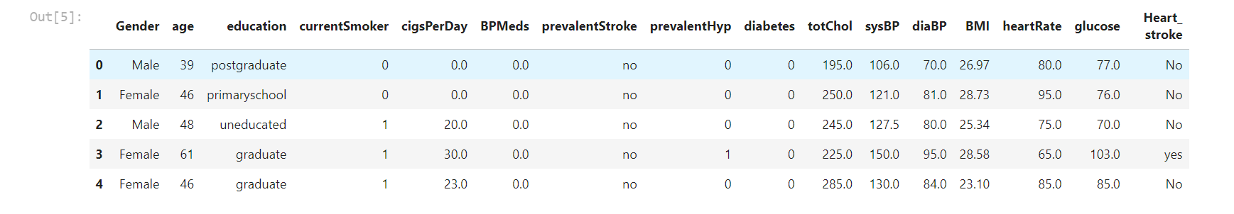
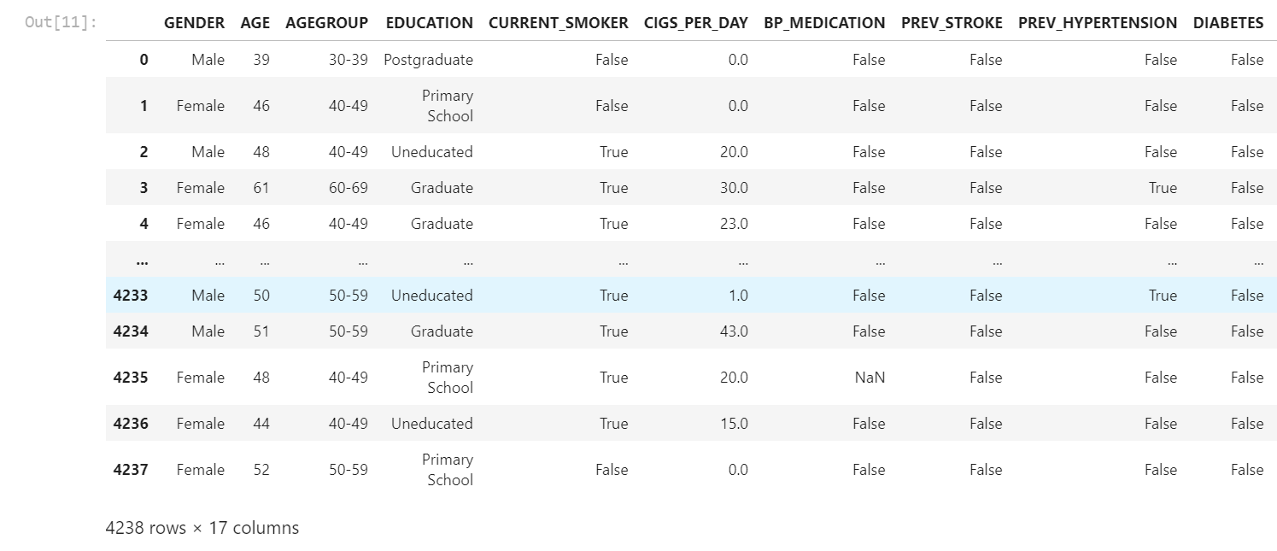
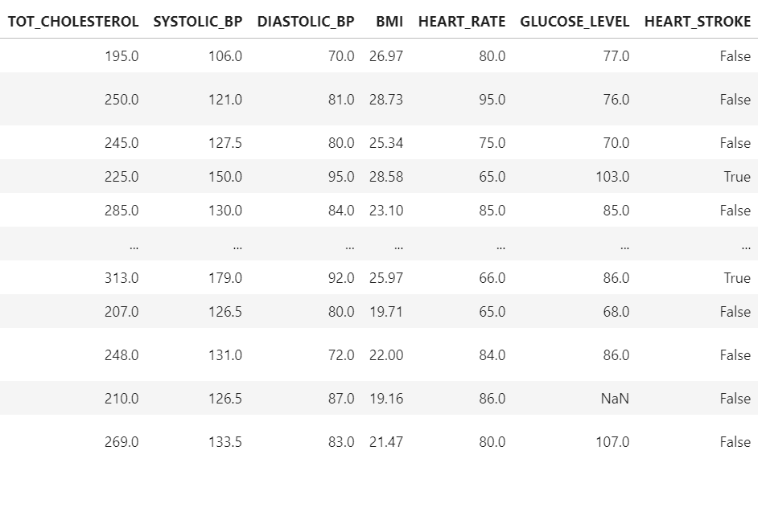
Data Preparation: Cleaned Data

Slide 10
Data Preparation: Manipulate Data Type
to_category
to_float32
to_int32
389.4KB → 171.1KB
Reduce memory usage → Achieve shorter processing time.
all categorical variables
from float64
from int64

Slide 11
03
Exploratory Analysis & Analytic Visualization

Slide 12
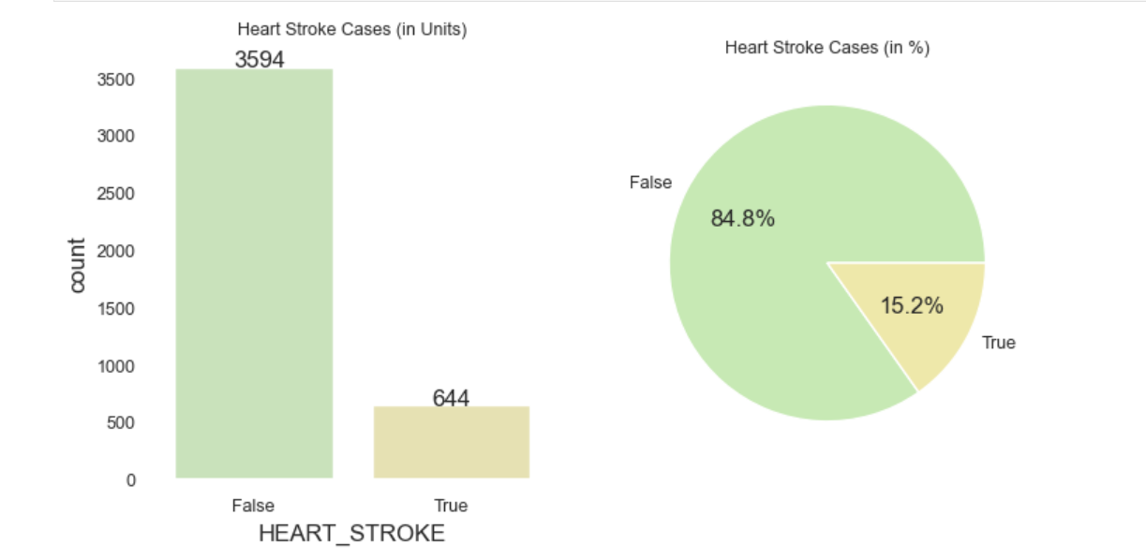
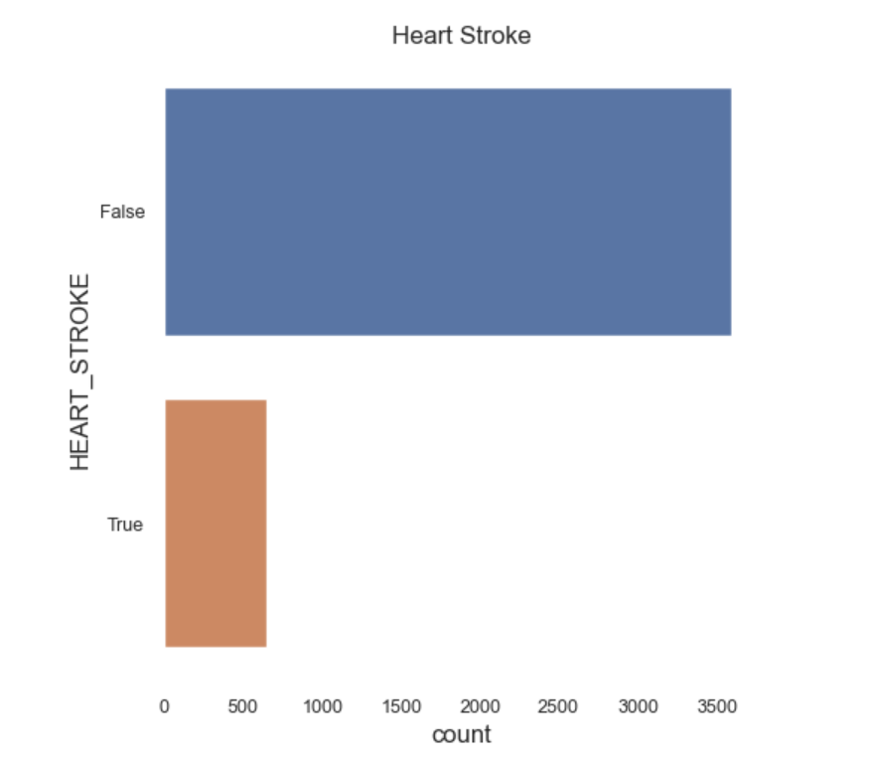
Response Variable: Heart Stroke

Slide 13
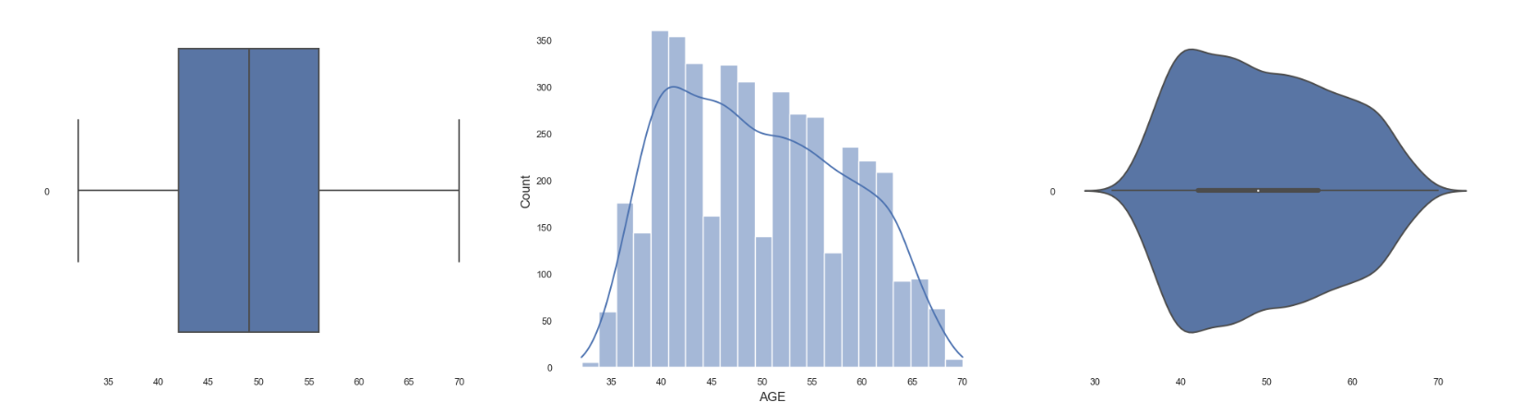
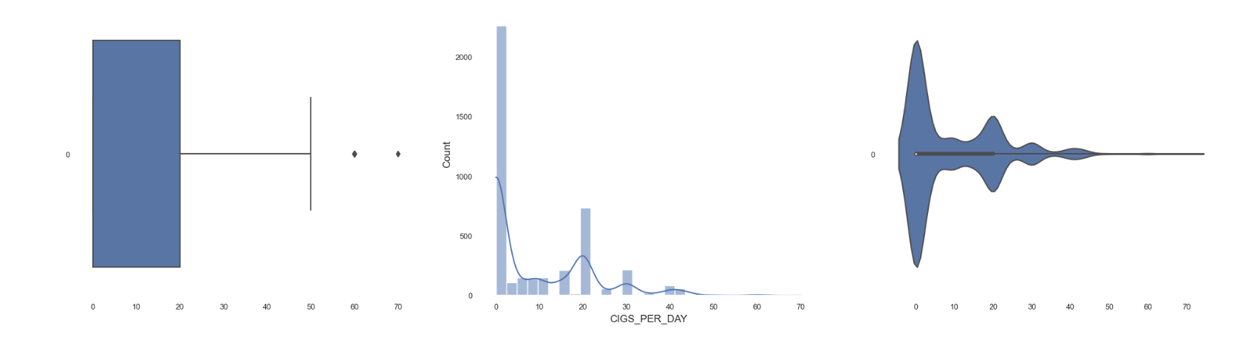
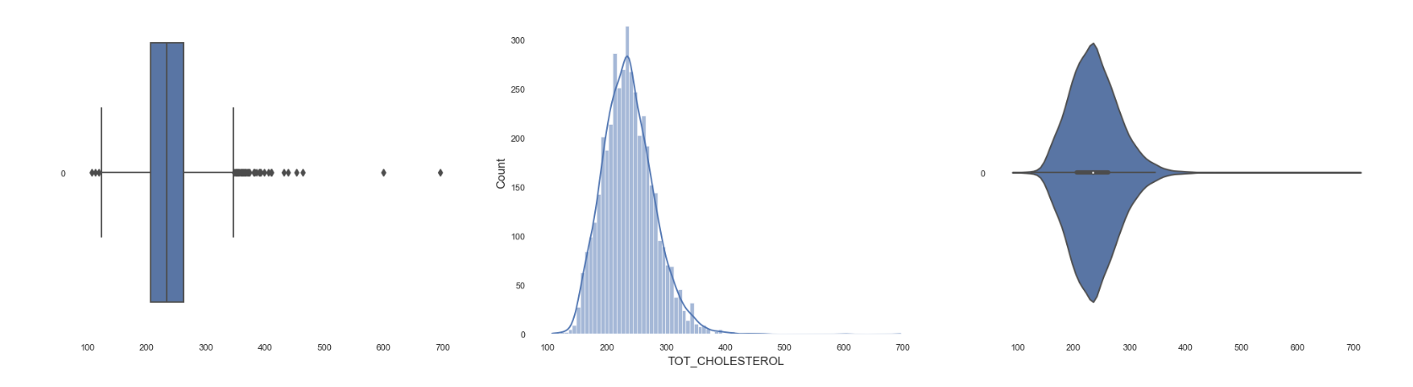
Numeric Predictors
Age
Cigarettes per Day
Total Cholesterol

Slide 14
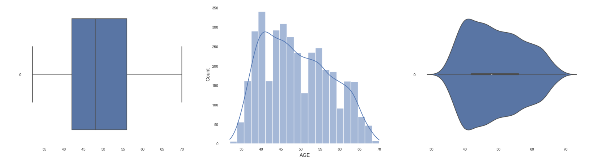
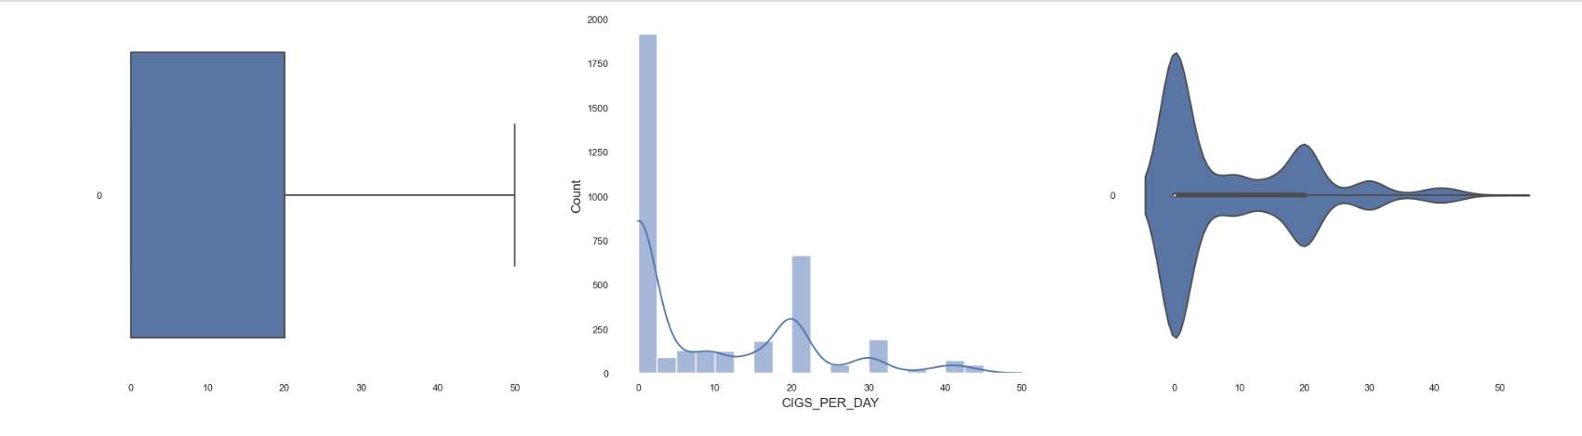
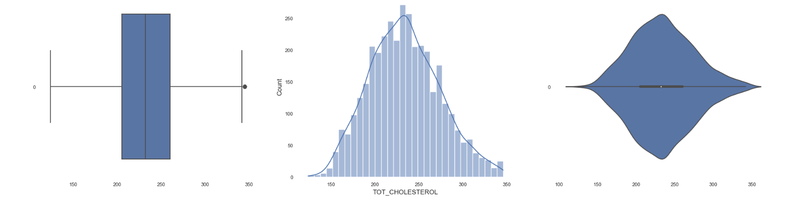
Numeric Predictors (Cleaned)
Age
Cigarettes per Day
Total Cholesterol

Slide 15
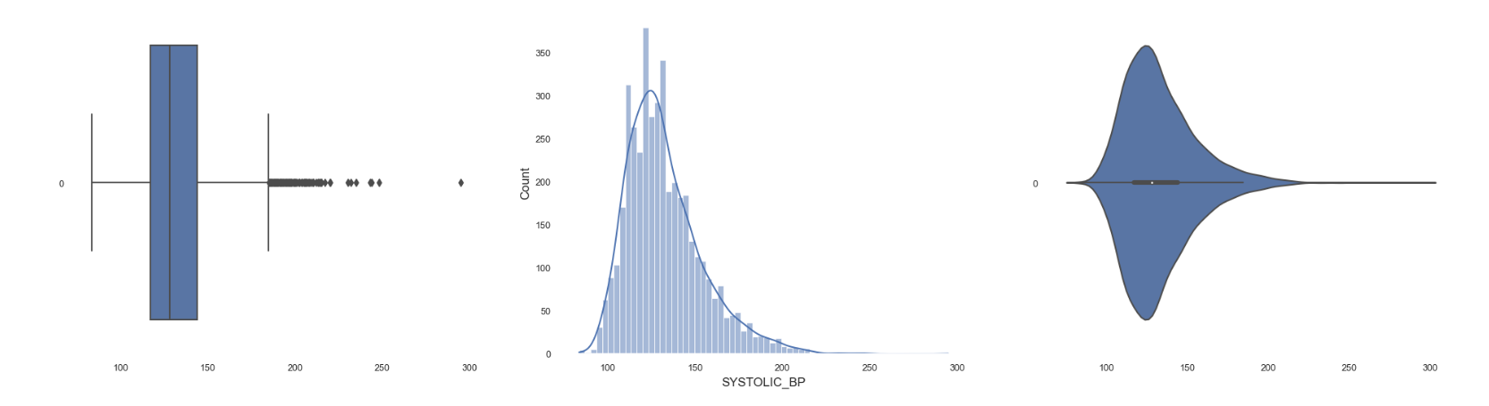
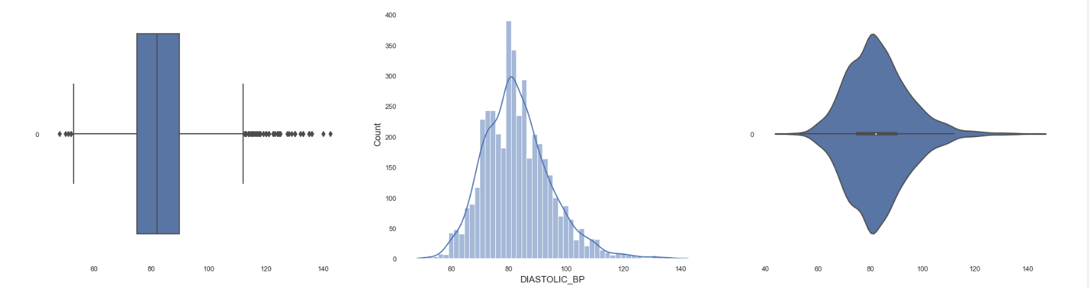
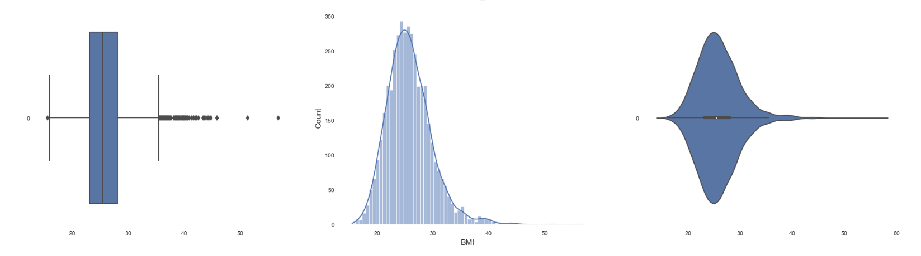
Numeric Predictors
Systolic Blood Pressure
Diastolic Blood Pressure
BMI

Slide 16
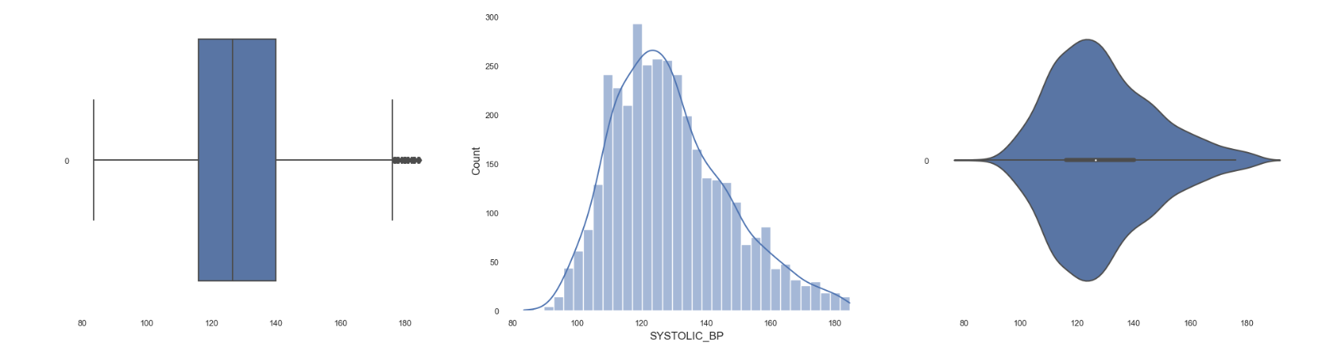
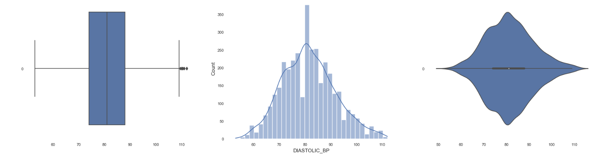

Numeric Predictors (Cleaned)
Systolic Blood Pressure
Diastolic Blood Pressure
BMI

Slide 17
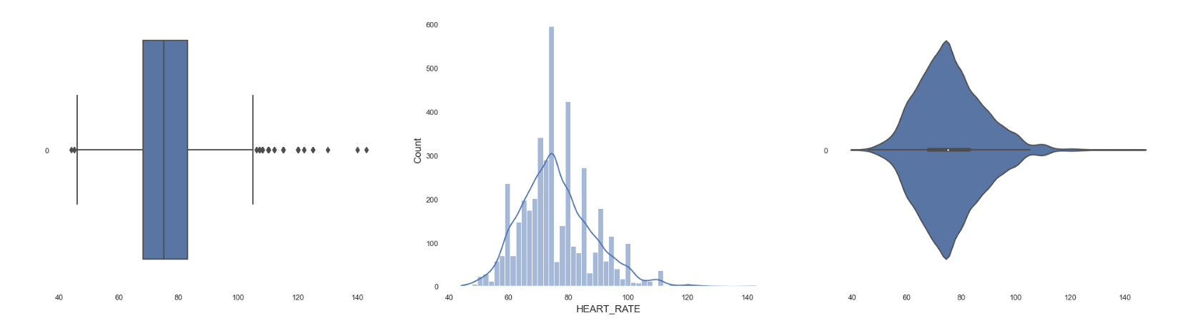
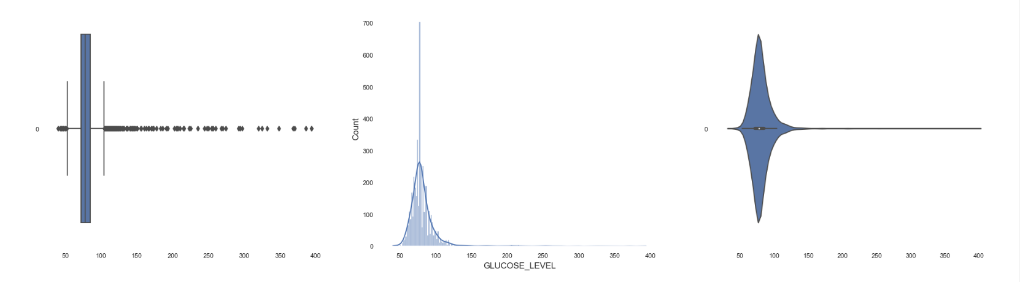
Numeric Predictors
Heart Rate
Glucose Level

Slide 18
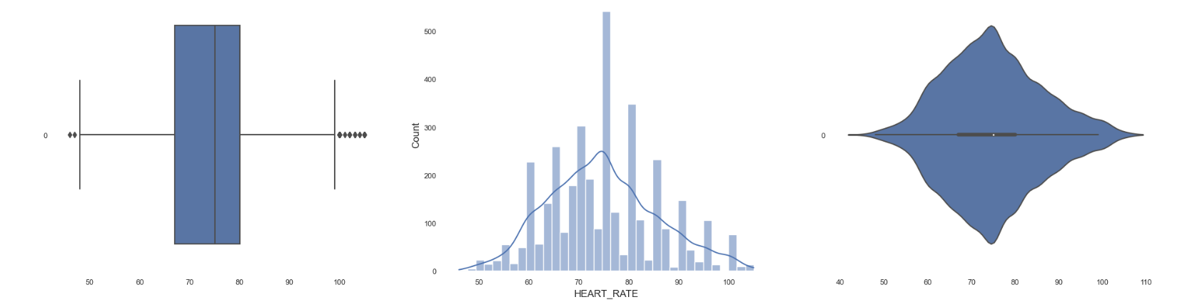
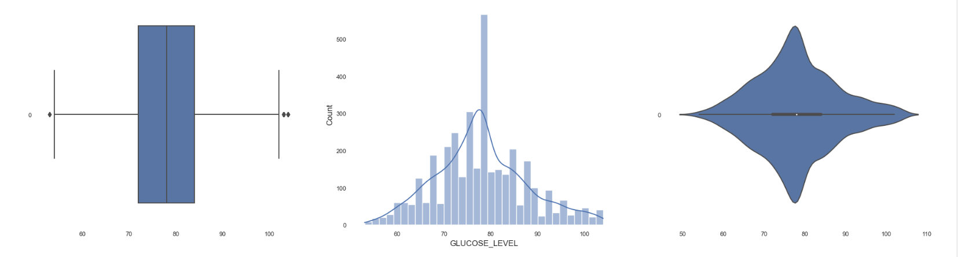
Numeric Predictors (Cleaned)
Heart Rate
Glucose Level

Slide 19
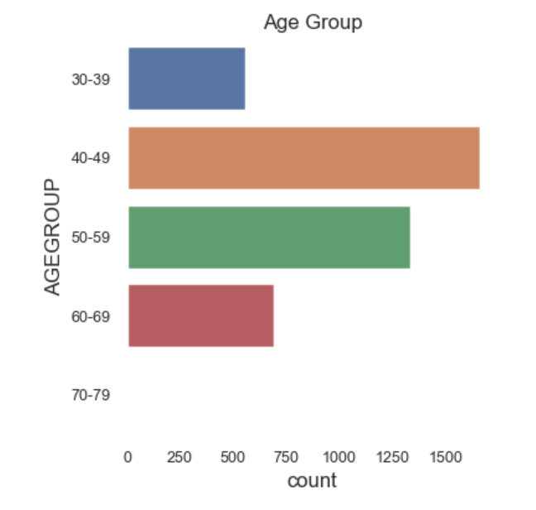
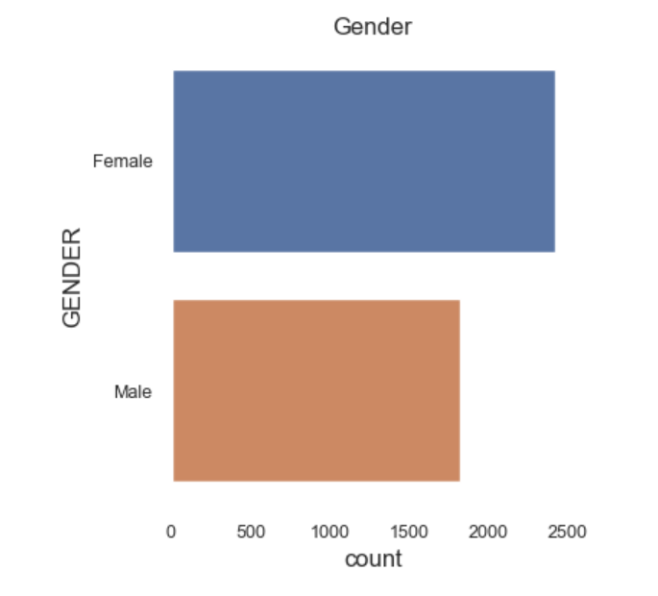
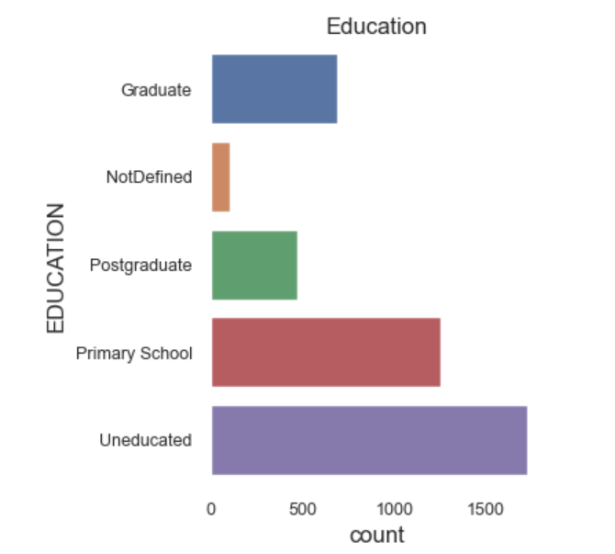
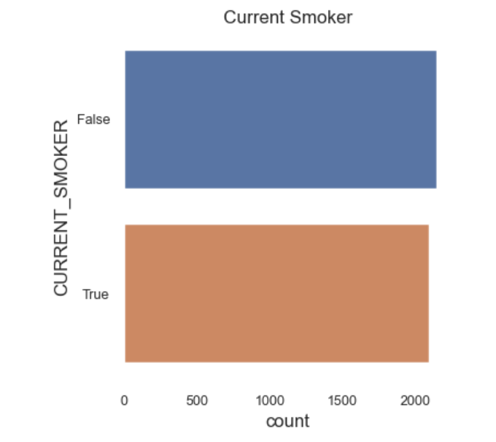
Categorical Predictors
Age Group
Gender
Current Smoker
Education

Slide 20
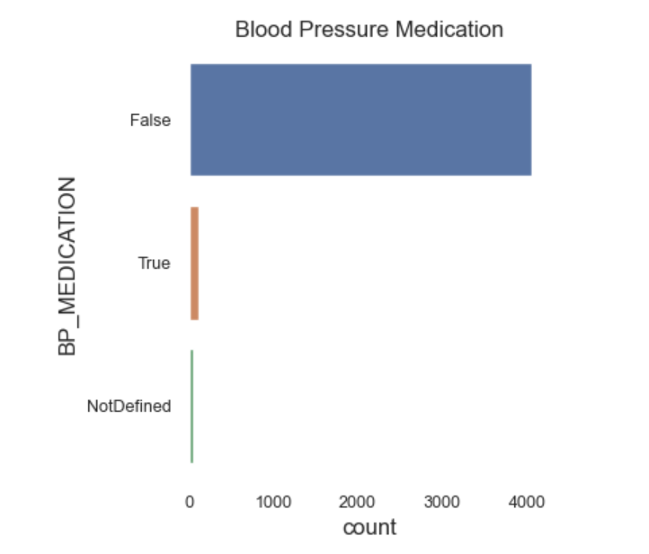
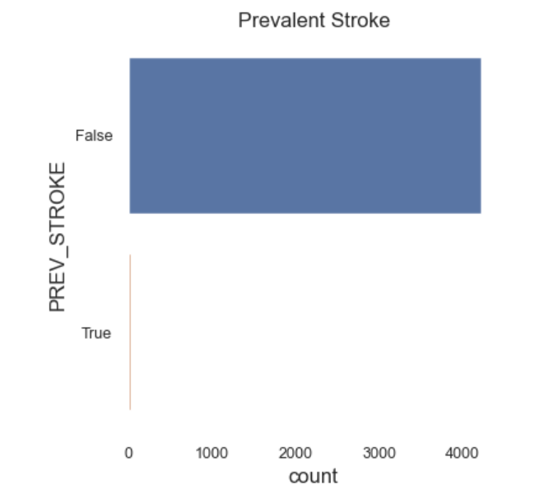
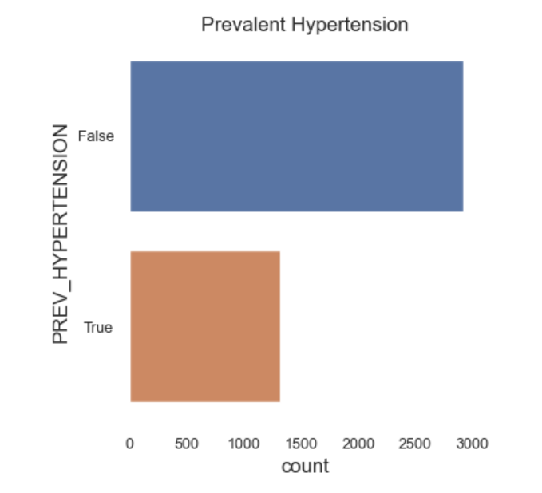
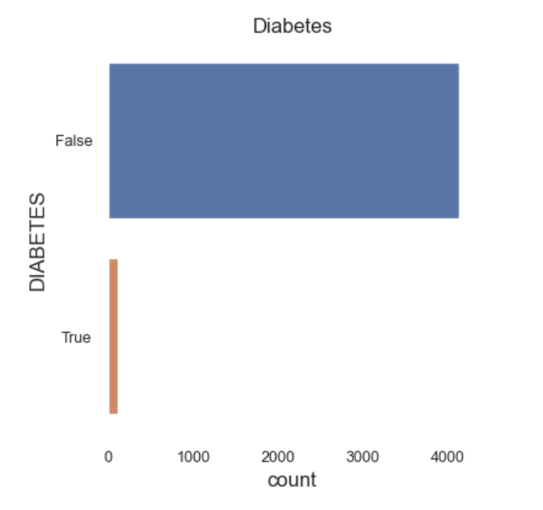
Categorical Predictors
Blood Pressure Medication
Prevalent Stroke
Prevalent Hypertension
Diabetes

Slide 21
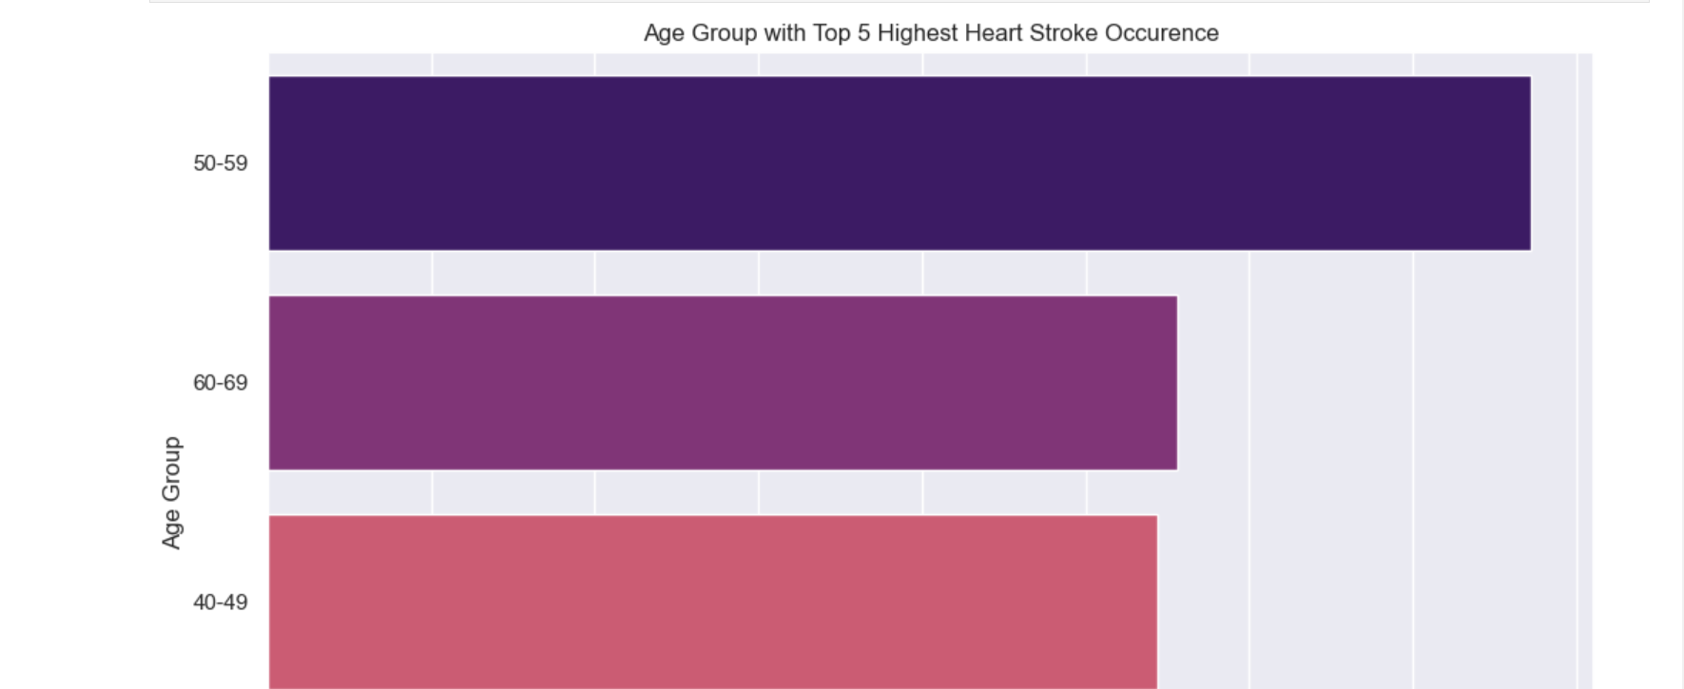
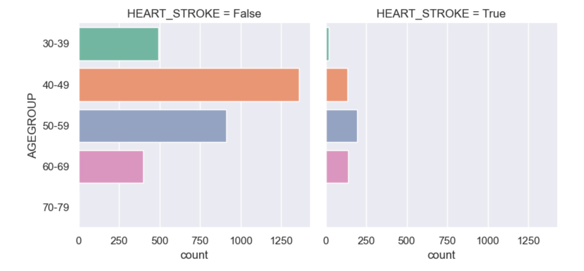
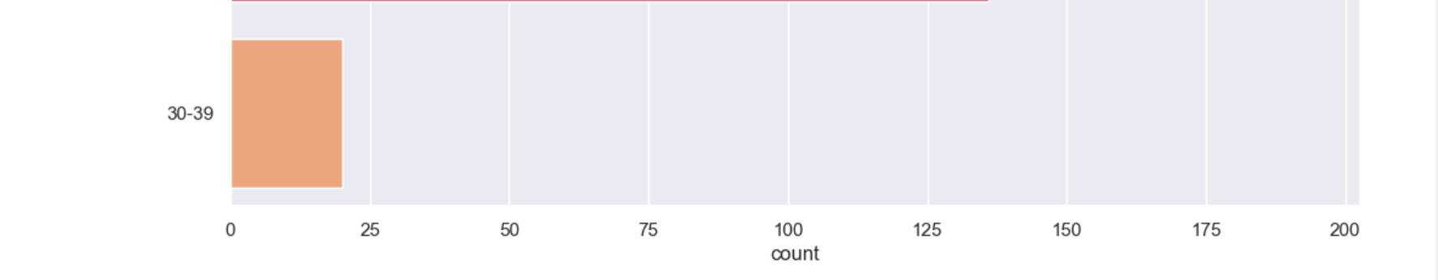
Relationship between Age Group and Heart Stroke Occurrence

Slide 22
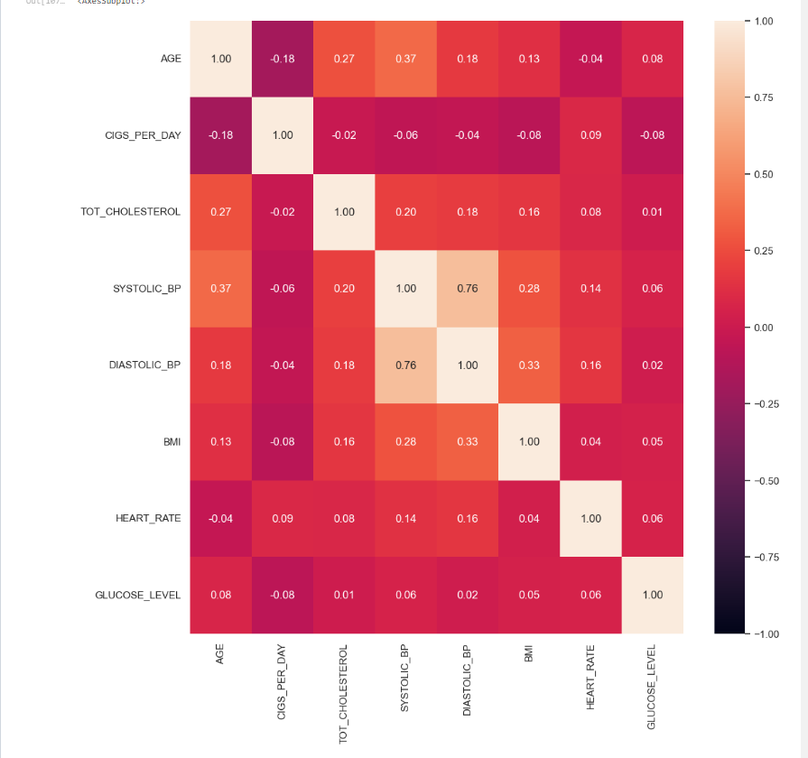
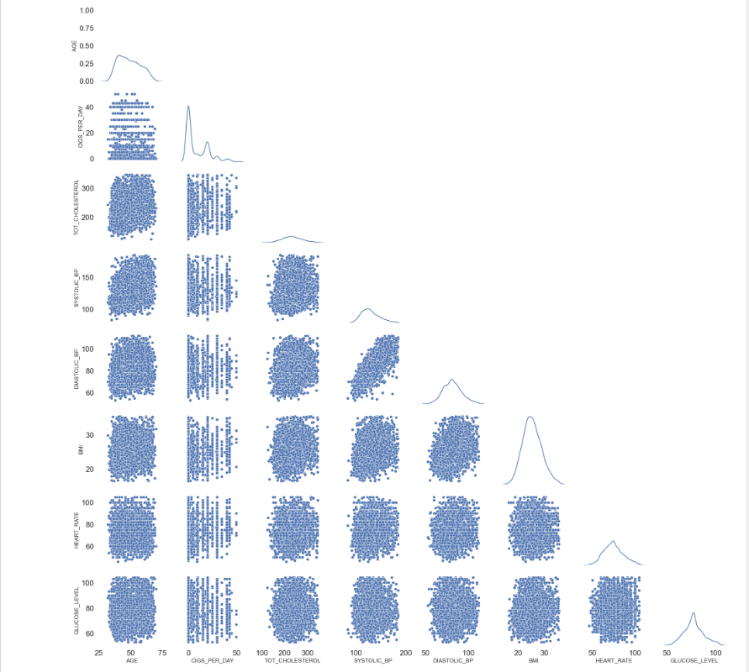
Correlation between Numeric Variables

Slide 23
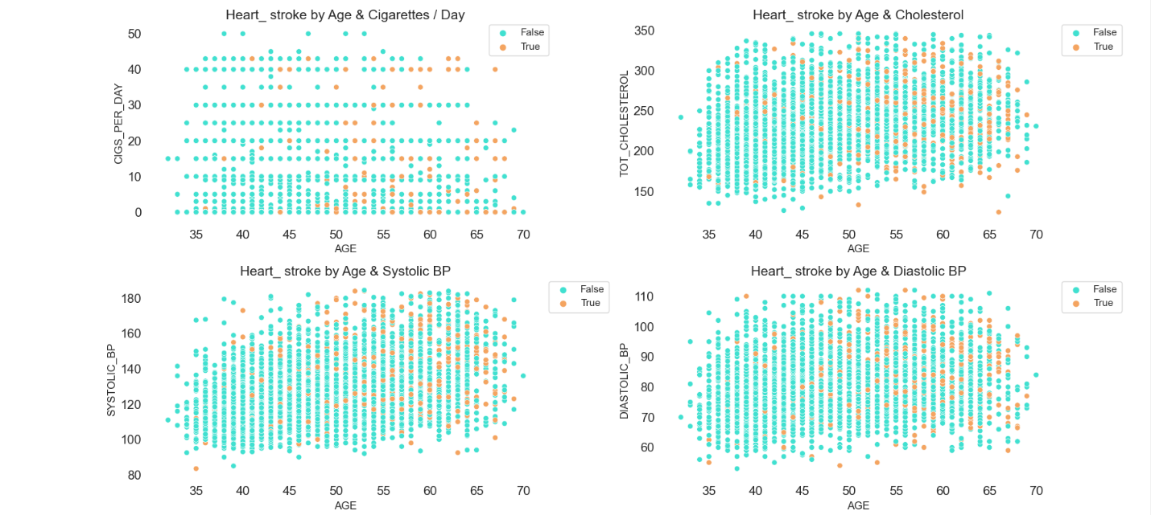
Impact of a combination of two numerical variables on Heart Stroke occurence

Slide 24
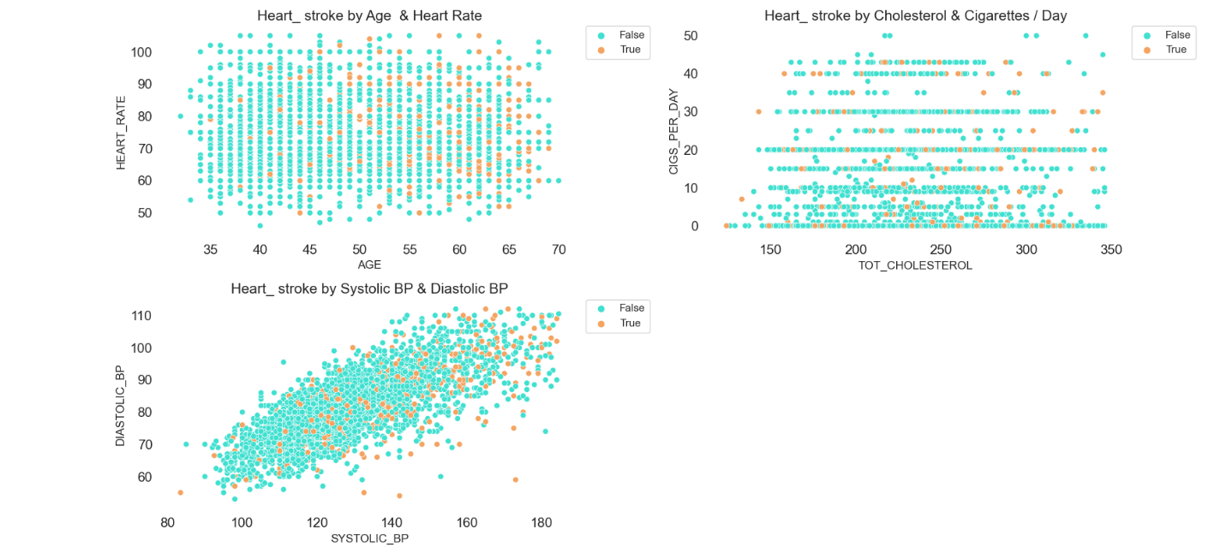
Impact of a combination of two numerical variables on Heart Stroke occurrence

Slide 25
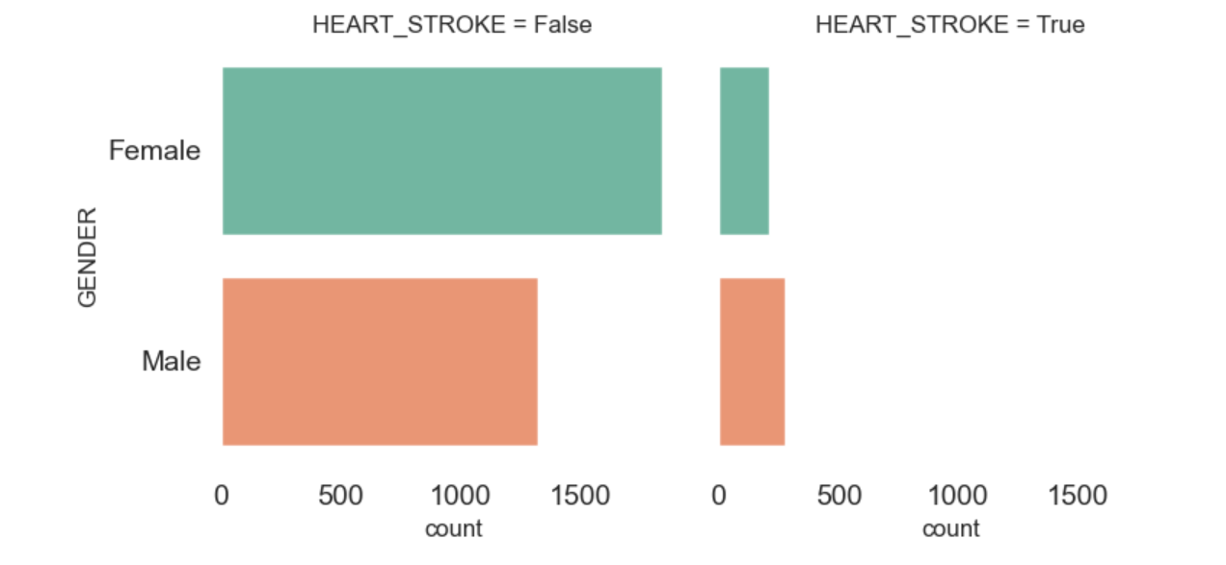
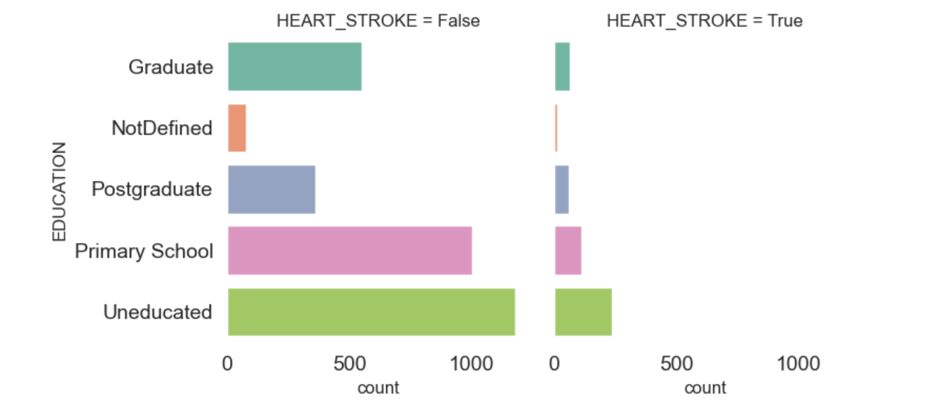
Findings for Problem Statement

Slide 26
Findings for Problem Statement
Individuals, more specifically men, with lower levels of education are at a higher risk for experiencing positive heart strokes.
Crucial to promote health education & awareness, particularly among males.

Slide 27
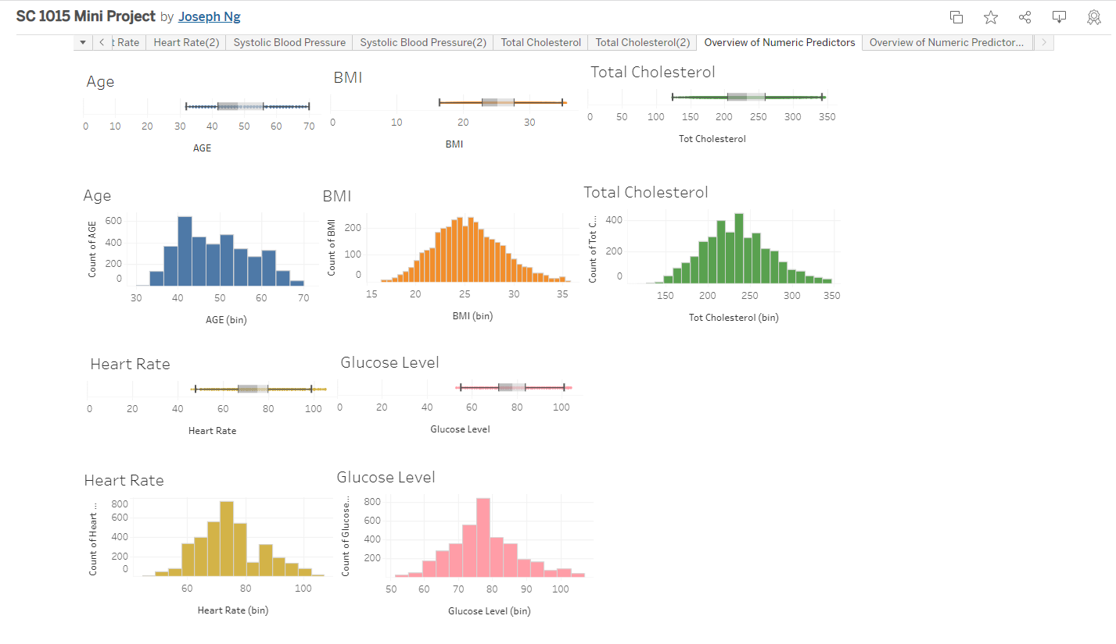
EDA via Tableau
Click here to explore the Tableau workbook.
Categorical Variables vs Heart Stroke
Overview of Numeric Predictors

Slide 28
04
Machine Learning &
Statistical Inference
Notes:
Next, we will be moving on to our machine learning and statistical inference portion.

Slide 29
Which is the best model to predict the occurrence of HEART STROKE?
Notes:
We will be employing various ML models and compare their accuracy and balance of data subsequently we will determine which is the best model would be the most effective to predict the presence of heart stroke.

Slide 30
Machine Learning
01
01
02
02
03
04
05
ML Models
Tools
Decision Tree Classifier
OneHotEncoder
Random Forest Classifier
Grid Search Cross-Validation
Balanced Bagging Classifier
Balanced Random Forest Classifier
Logistic Regression
Notes:
Here are the machine learning models and strategies we will be implementing, and the tools to aid our usage of the ML models.

Slide 31
OneHotEncoder
Encodes categorical features and assign a 1 or 0 value in a column
Notes:
We will first be using OneHotEncoder which allows us to encode categorical values and assign a 1 or 0 value to that column for usage later. This prepares our data in a format that is usable for the various ML models we will be implementing later.

Slide 32
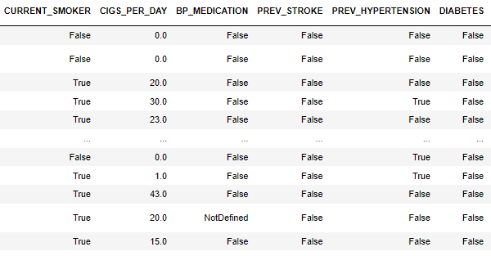
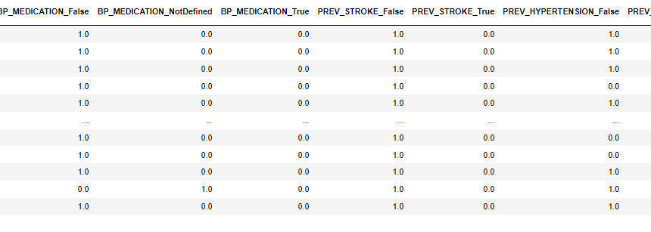
Before
After
Notes:
These tables show the results of using OneHotEncoder

Slide 33
Response Variable
Occurrence of HEART_STROKE = 1
No occurrence of HEART_STROKE = 0
Notes:
Our response variable is the occurrence of heart stroke for the patient, which is categorical in nature. 1 for the occurrence of heart stroke and 0 when it does not occur

Slide 34
DecisionTreeClassifier
Supervised Machine Learning Algorithm to make decisions
Notes:
Our first model is the Decision Tree classifier. Decision Tree is a Supervised Machine Learning Algorithm that uses a set of rules to make decisions.

Slide 35
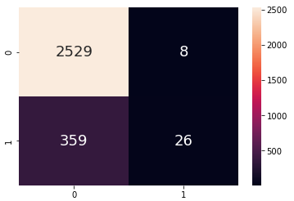
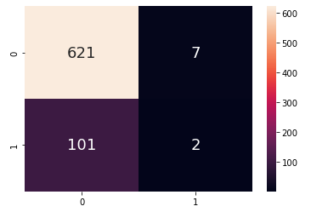
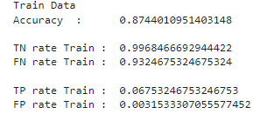
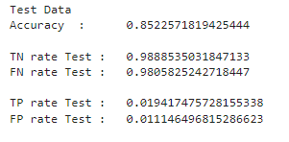
Decision Tree Classifier (Initial Data)
Training Set
Test Set
High accuracy but extreme values
Extremely high TN and FN rates
Extremely Low TP and FP rates
Notes:
It yields rather good accuracy value of around 0.85,but there are extreme values .There are very high TN and FN rates and concurrently extremely low TP and FP rates.

Slide 36
Resampling
Improve imbalance of data
Notes:
We will be performing Resampling to remove the imbalance of data in our dataset.

Slide 37
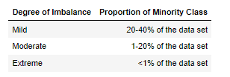
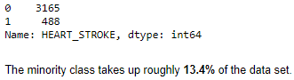
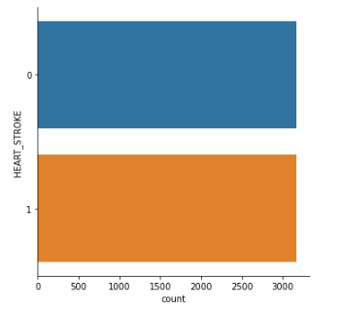
Resample - Upsampling Our Data
Resample size of data of those where HEART_STROKE does occur (1) to the size of where HEART_STROKE does not (0)
Balances Values and reduces bias towards one class of data
Notes:
The amount of data with the occurrence of heart stroke (the positives) is much higher than the those without the occurrence of heart stroke (the negatives) in our dataset.
It can be described as moderately imbalanced. Thus we resample the data to make it balance by upsampling the data of 1 to the size of sample of 0. As such, our data will no longer be biased towards the occurrence of heart stroke.

Slide 38
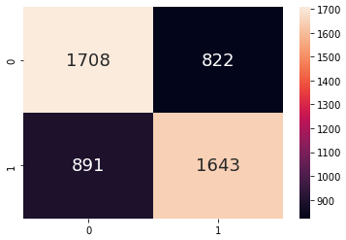
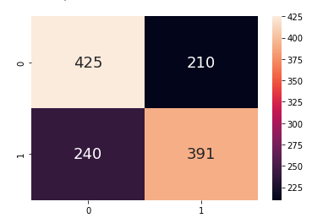
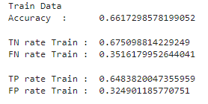

DecisionTreeClassifier (Upsampled Data)
Training Set
Test Set
Lower accuracy
Not biased towards specific category
Rate test values are not that extreme
Notes:
However, this reduces the accuracy of the model, but at least we are no longer biased towards any of the two categories. For both train and test data, we can see that the extreme low and high values we had previously are gone.

Slide 39
Cross-Validation
To improve accuracy
Notes:
We will be performing Cross-Validation to improve the accuracy of our data.

Slide 40

Cross-Validation (GridSearchCV) on DecisionTreeClassifier (Upsampled Data)
Model Performs exhaustive search over specified parameter values for an estimator
Find fixed number of folds (or partitions of the data, run the analysis on each fold and then average the overall error estimate
Best model : Depth = 9
Notes:
Cross-validation is a statistical method used to estimate the performance (or accuracy) of machine learning models. It is used to protect against overfitting in a predictive model, particularly in a case where the amount of data may be limited. In cross-validation, you make a fixed number of folds (or partitions) of the data, run the analysis on each fold, and then average the overall error estimate.We then use cross-validation to find the best model which is the depth 9.

Slide 41






Training Set
Test Set
Higher Accuracy
Notes:
Running a max depth of 9 proved to be effective in improving our accuracy from just directly using the Decision Tree classifier from the upsampled data in the previous model.

Slide 42
RandomForestClassifier
Meta Estimator that fits a number of decision tree classifiers
Notes:
A random forest is a meta estimator that fits a number of decision tree classifiers on various sub-samples of the dataset and uses averaging to improve the predictive accuracy and control over-fitting. Intuitively, it would yield a higher accuracy as compared to the DecisionTreeClassifier.

Slide 43




RandomForestClassifier (Upsampled Data)
Training Set
Test Set
Notes:
Here are the results for RandomForestClassifer with the Upsampled Data. As we have learnt that upsampling has improved the balance of our data, we will skip performing it with pre-Upsampled data.

Slide 44




Cross-Validation (GridSearchCV) on Random Forest Classifier
Cross-Validation (GridSearchCV) on Random Forest Classifier
Training Set
Test Set
Notes:
Similarly, We perform Cross-Validation on Random Forest Classifiier like how we did on the DecisionTreeClassifier to improve the accuracy.

Slide 45
Comparison Between Models After Cross-Validation
Training Set
Test Set
DecisionTreeClassifier
DecisionTreeClassifier
Higher accuracy than Decision Tree before Cross Validation
More balanced accuracy amongst each category
Less overfitting as compared to Decision Tree Classifier
RandomForestClassifier
RandomForestClassifier
Notes:
Indeed, referring to our test data, (CLICK) the accuracy for RandomForestClassifier is higher than the DecisionTreeClassifier when after Cross-Validation has been performed on both of the models.
Additionally, the accuracy across each category is more balanced here as well. For example, (CLICK) the TN rate for the DecisionTreeClassifier is about 0.74 while the accuracy for the TP rate is all the way at 0.86. Whereas, for the RandomForestClassifier. TN is rate is 0.82 and TP rate is 0.85, the difference being way lower.
This model also deters from overfitting and limits error due to biasness as compared to a DecisionTreeClassifier, making it the better of the two models.

Slide 46
BalancedBaggingClassifier
Utilises a combination of bagging and resampling techniques to create a more balanced dataset.
Notes:
We will now try another ML model. A random forest is a meta estimator that fits a number of decision tree classifiers on various sub-samples of the dataset and uses averaging to improve the predictive accuracy and control over-fitting.

Slide 47




Training Set
Test Set
High Accuracy
More Evenly Distributed

Slide 48
BalancedRandomForestClassifier
Utilises the random sampling technique to create a more balanced dataset.
Notes:
We will now try another ML model. A random forest is a meta estimator that fits a number of decision tree classifiers on various sub-samples of the dataset and uses averaging to improve the predictive accuracy and control over-fitting.

Slide 49




Training Set
Test Set
Slightly Lower (Moderate) Accuracy
More Evenly Distributed

Slide 50
Logistic Regression
models the probability of a discrete outcome given an input variable
Notes:
Our last ML model is the logistic regression model which predicts the probability of an outcome.

Slide 51




Training Set
Test Set
Moderate Balanced Accuracy
Notes:
After applying our data to the trained model,we have a classification report which examines the precision, recall, f1-score and support, which are very useful indicators to evaluate the usefulness of our data. The accuracy is higher for negative heart stroke and lower for positive heart stroke. The balanced accuracy of the train model is 0.51 and 0.50 for the test model, though it is less ideal.

Slide 52

eli5
feature of relative importance
Notes:
We also used eli5, stands for Explain Like I'm 5 to show the feature of relative importance of each factor in this table here.

Slide 53
Model | DecisionTreeClassier (Initial Data) | DecisionTreeClassier (Upsampled Data) | Cross-Validation (GridSearchCV) on Decision Tree Classifier (Upsampled Data) | RandomForestClassifier (Upsampled Data)
Balance | Not Evenly Distributed | Less Evenly Distributed | Less Evenly Distributed | More Evenly Distributed
Accuracy | High | Moderate | High | Moderate

Slide 54
Model | Cross-Validation (GridSearchCV) on Random Forest Classifier (Upsampled Data) | BalancedBaggingClassifier | BalancedRandomForestClassifier | Logistic Regression
Balance | More Evenly Distributed | More Evenly Distributed | More Evenly Distributed | Moderately Distributed
Accuracy | High | Highest | Moderate | Moderate

Slide 55
Optimal Model: BalancedBaggingClassifier

Slide 56
THANK YOU

Slide 57
References
The National Institute for Occupational Safety and Health (NIOSH). (2022, May 13). Heat stress related illness. Centers for Disease Control and Prevention. Retrieved April 15, 2023, from https://www.cdc.gov/niosh/topics/heatstress/heatrelillness.html#:~:text=Heat%20Stroke,-Heat%20stroke%20is&amp;text=It%20occurs%20when%20the%20body,within%2010%20to%2015%20minutes.
Pedregosa et al. (2011). Scikit-learn: Machine Learning in Python. JMLR 12, pp. 2825-2830.‌​
What is Cross Validation in Machine Learning? Types of Cross Validation. (2020, September 24). GreatLearning Blog: Free Resources What Matters to Shape Your Career! https://www.mygreatlearning.com/blog/cross-validation/ ​
Imbalanced Data | Data Preparation and Feature Engineering for Machine Learning | Google Developers. (2021). Google Developers. https://developers.google.com/machine-learning/data-prep/construct/sampling-splitting/imbalanced-data ​
Bento, C. (2021, June 28). Decision Tree Classifier explained in real-life: picking a vacation destination. Medium; Towards Data Science. https://towardsdatascience.com/decision-tree-classifier-explained-in-real-life-picking-a-vacation-destination-6226b2b60575 ​
Yadav, D. (2019, December 6). Categorical encoding using Label-Encoding and One-Hot-Encoder. Medium; Towards Data Science. https://towardsdatascience.com/categorical-encoding-using-label-encoding-and-one-hot-encoder-911ef77fb5bd ​
Lemaître, G., Nogueira, F., & Aridas, C. K. (2017). Imbalanced-learn: A Python Toolbox to Tackle the Curse of Imbalanced Datasets in Machine Learning. Journal of Machine Learning Research, 18(17), 1–5. https://jmlr.org/papers/v18/16-365.html ​
IBM Cloud Education. (2021, May 11). What is Bagging? Ibm.com. https://www.ibm.com/cloud/learn/bagging#:~:text=Bagging%2C%20also%20known%20as%20bootstrap,be%20chosen%20more%20than%20once ​

